Slide 1
World population analysis
- By Lekhana

Slide 2
Data Set Overview
The dataset consist of 3 tables.
The table 1 and 2 share the columns structure and provide data on the global male and female populations, categorezied by age, group and country.
Table 1 covers the years 2002-2049, while table 2 spans from 2040-2099,table 3 contains information about the countries continents .

Slide 3
Tools used
Microsoft Power BI

Slide 4
Data cleaning
Data cleaning (also known as data cleansing or data scrubbing) is the process of detecting and correcting (or removing) errors and inconsistencies in data to improve its quality and ensure it’s accurate, complete, and ready for analysis or modelling.

Slide 5
Data Modelling
Data modelling is the process of creating a structured framework for how data is stored, connected, and accessed in a system. It helps in organizing data logically so it can be efficiently used in databases, analytics, or software applications.

Slide 6
Data Analysis
I created a report using chats and slices based on the data.
To analyse the population data, I created several measures. This includes the number of countries, the average population and the population running total .

Slide 7
Findings
Population = 943billion
Number of countries = 194

Slide 8
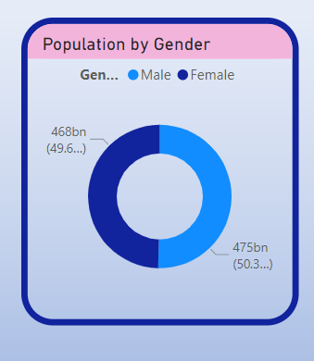
What is the Global distribution of the male and female population ?
Across the World, The male and female population are distributed almost equally with only slight difference.

Slide 9
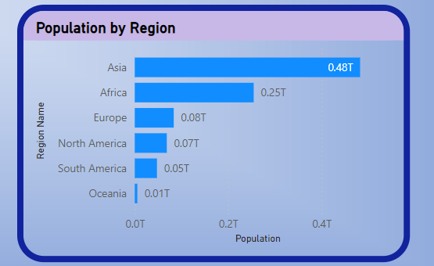
Which Region is highest population ?
Among all the regions, Asia is the most populated followed by Africa is in 2nd place while Oceania is least populated.

Slide 10
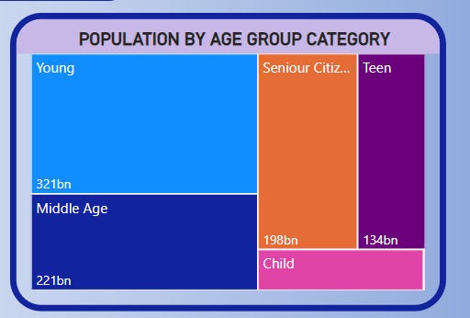
Which Age Group has the largest population ?
Largest population = 25%
Smallest population = 7%
Middle aged and children = 37%

Slide 11
Recommendations
To reduce population growth in Asia , key strategies include improving family planning, education especially for women, and health care.
Promoting urbanization, economic growth and social security along with incentives for smaller families.
Advancing gender equality and parental support also contributes to managing growth while enhancing quality of life
There is no need to focus on increasing the population in Oceania, Africa and North America as it has experienced steady population growth over the years.

Slide 12
